Slide 1

Thesis Title Comprehensive Fingerprint Recognition Utilizing One Shot Learning With Siamese Network
Group ID: T2210011
Department of Computer Science & Engineering, Brac University
Sara Milham Zaman (19101141)
Md. Abir Hasan (18201019)
Md. Rafid Sadat (22341053)
Md. Abrar Haque (19101648)
Supervisor: Faisal Bin Ashraf Lecturer Department of CSE Brac University

Slide 2
Problem Statement
Comprehensive Fingerprint Recognition Utilizing One Shot Learning With Siamese Network
Deep CNN have become the state of the art methods for image classification
However, one of the biggest limitations is they require a lots of labeled data
Collecting this much data is not feasible
Cannot deal with dynamic data
One Shot Learning aims to solve this problem
Department of Computer Science & Engineering, Brac University

Slide 3
Motivation
Comprehensive Fingerprint Recognition Utilizing One Shot Learning With Siamese Network
Reducing Data Complexity
Adaptability with dynamic classifications
Reducing Time Complexity
Solving data scarcity issue
Cost Effective
Classification of gender, hand, finger to reduce the suspect list
Department of Computer Science & Engineering, Brac University

Slide 4
Background and Related Works
Comprehensive Fingerprint Recognition Utilizing One Shot Learning With Siamese Network
Pre-requisites :
Deep CNN
Fingerprint
Transfer Learning
Siamese Network
Triplet Loss Function
Performance Metrics
SOCOFing Dataset
Department of Computer Science & Engineering, Brac University

Slide 5
Background and Related Works
Comprehensive Fingerprint Recognition Utilizing One Shot Learning With Siamese Network
Detailed Identification of Fingerprints Using Convolutional Neural Networks-2018
Strong Points - CNN learning features ; Identification of Gender , Hand and Fingers ; Over 93% accuracy in Hand identification.
Weak Points - Trained very deep CNN which can be complex ; Gender and Finger accuracy is very low .
Algorithms Used : Convolutional Network Network (CNN) , Transfer Learning
Fingerprint Classification Through Image Analysis and Machine Learning -2019
Strong Points -High Accuracy Rate ; Reduce the number of comparisons in automatic fingerprint recognition systems with large databases .
Weak Points - Often give an error due to of the low-quality input image.
Algorithms Used : Computer Vision algorithms, SVM algorithm, RF algorithm.
Evaluation of Fingerprint Liveness Detection by Machine Learning Approach - A Systemic View -2021
Strong Points -Gives better performance in Fingerprint detection than image recognition method with RT due to ensemble classifier ; Use of dataset augmentation to improve accuracy ; Obtaining better results through software processing algorithms.
Weak Points - Relied on RT for image feature extraction to provide accurate identification ; Only the single classifier can show accuracy for unknown materials ; Lower accuracy while using unknown materials for spoof detection.
Algorithms Used : Support Vector Machine, Single and Ensemble Classifier.
Department of Computer Science & Engineering, Brac University

Slide 6
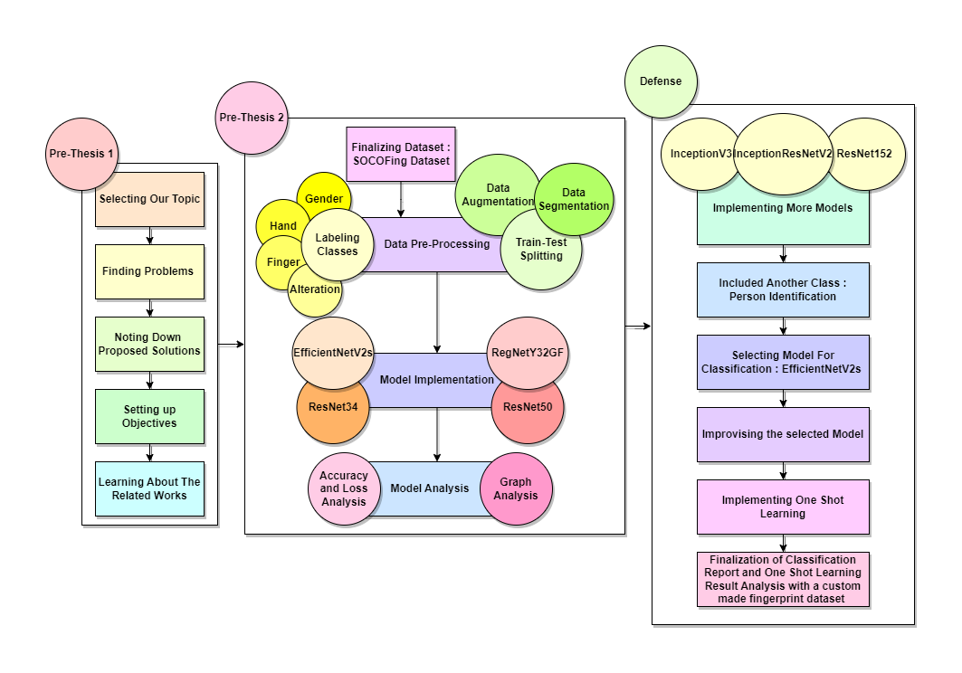
Workflow
Comprehensive Fingerprint Recognition Utilizing One Shot Learning With Siamese Network
Department of Computer Science & Engineering, Brac University

Slide 7
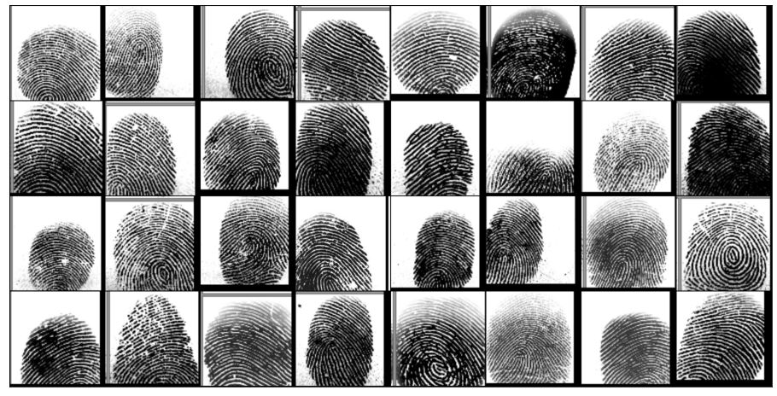
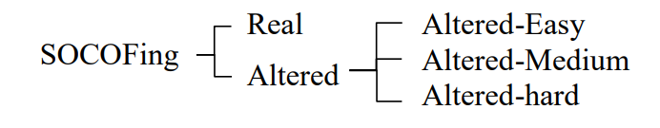
Dataset
Dataset Acquisition
Socoto Coventry Fingerprint Dataset (Reference)
Dataset Description
600 African candidates
Real Images 6000
Altered Images 49273
Number of Altered Images
Easy : 17,934 images .
Medium : 17,067 images
Hard : 14,272 images.
Fig: Dataset Sample

Slide 8
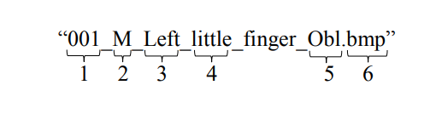
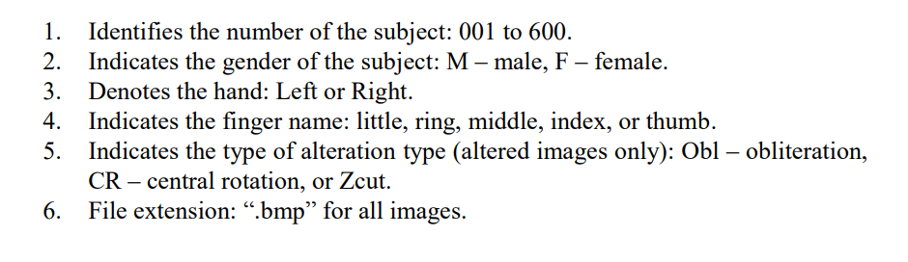
Dataset Image Naming Convention
Comprehensive Fingerprint Recognition Utilizing One Shot Learning With Siamese Network

Slide 9
Dataset Preprocessing
Comprehensive Fingerprint Recognition Utilizing One Shot Learning With Siamese Network
Data Augmentation
Resize Pixel
Reflect
Random Crop
Data Segmentation
Person Class
Gender Class(Male/Female)
Hand Class (Left & Right)
Finger Types (5 types)
Alteration Class
Data Train-Test Splitting
Ratio
Training : 90%
Testing : 10%

Slide 10
Models Used
Comprehensive Fingerprint Recognition Utilizing One Shot Learning With Siamese Network
Models | Accuracy | Epoch
ResNet34 | 84.43% | 16th
ResNet50 | 82.24% | 18th
RegNet_Y_3_2GF | 84.95% | 21st
EfficientNetV2S | 99.73% | 49th
Fig: Result Comparison of Gender Class
Department of Computer Science & Engineering, Brac University

Slide 11
Models Used
Comprehensive Fingerprint Recognition Utilizing One Shot Learning With Siamese Network
Models | Accuracy | Epoch
ResNet34 | 84.43% | 23rd
ResNet50 | 82.50% | 18th
RegNet_Y_3_2GF | 82.19% | 22nd
EfficientNetV2S | 97.09% | 22nd
Fig: Result Comparison of Hand Class
Department of Computer Science & Engineering, Brac University

Slide 12
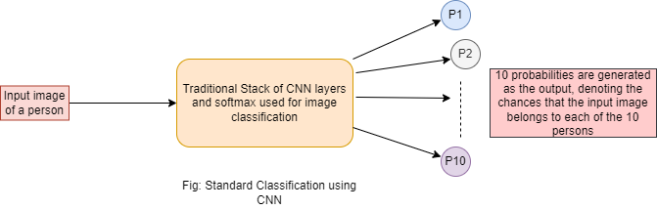
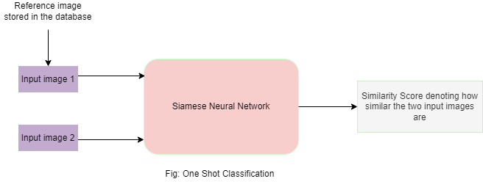
Proposed Method
Comprehensive Fingerprint Recognition Utilizing One Shot Learning With Siamese Network
Classification
EfficientNetV2s
5 classes (Person, Gender , Hand , Finger , Alteration)
One Shot Learning
Siamese Network
Triplet Loss Function
Department of Computer Science & Engineering, Brac University

Slide 13
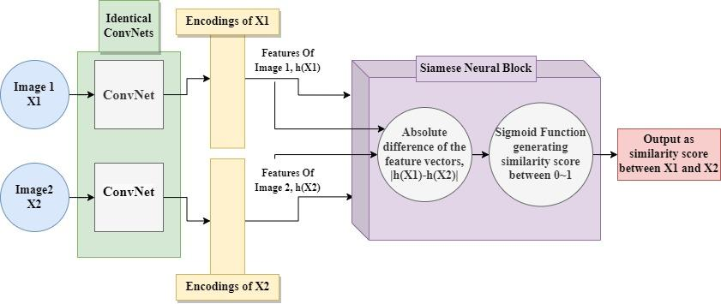
Proposed Methods : One Shot Learning
Comprehensive Fingerprint Recognition Utilizing One Shot Learning With Siamese Network
Department of Computer Science & Engineering, Brac University

Slide 14
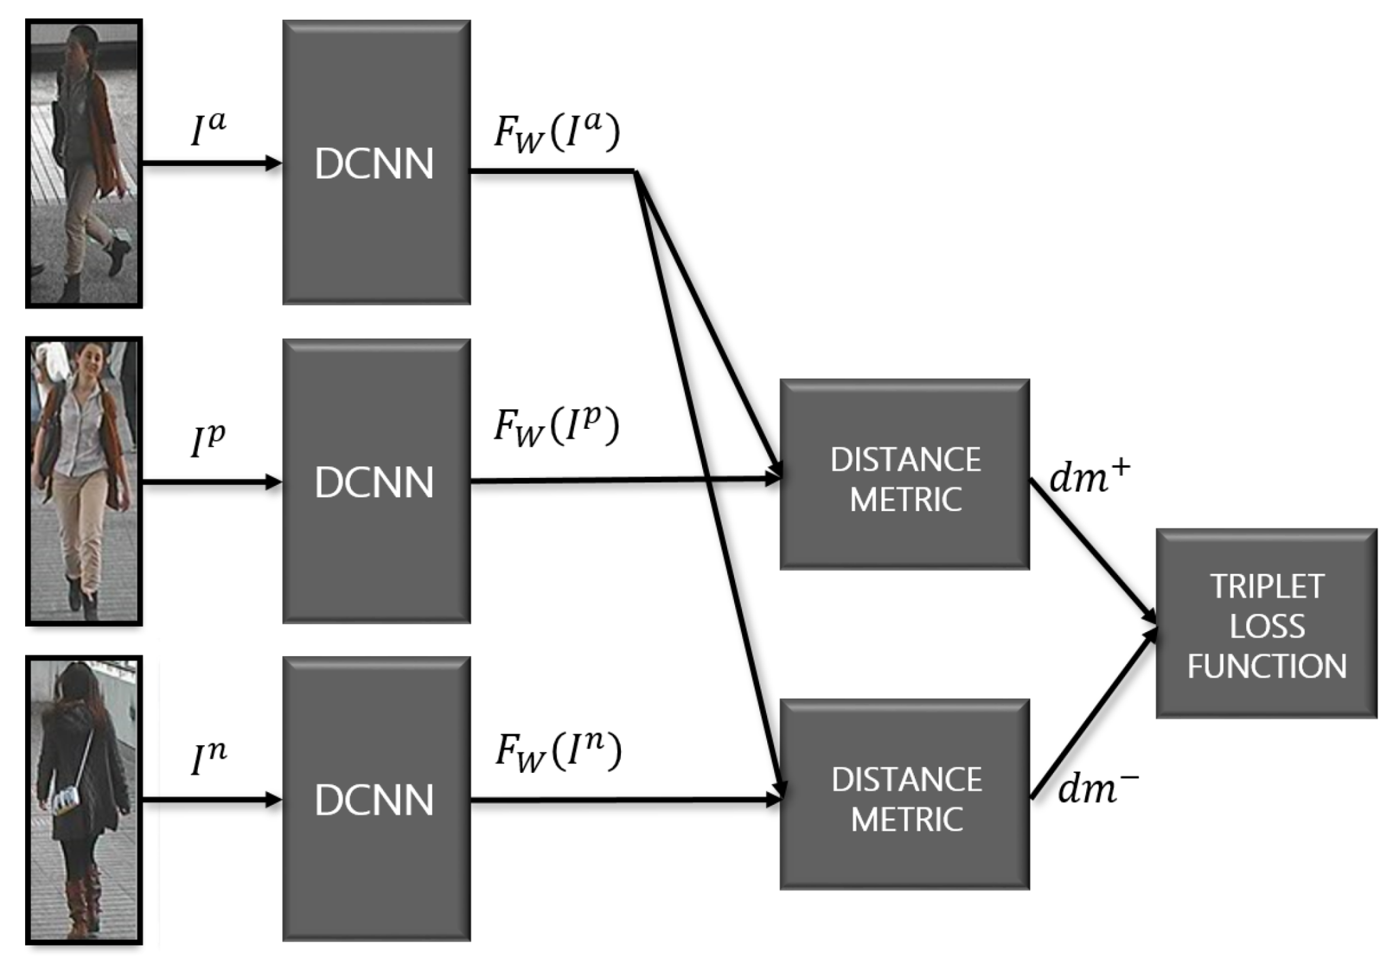
Proposed Methods : Siamese Network
Comprehensive Fingerprint Recognition Utilizing One Shot Learning With Siamese Network
Department of Computer Science & Engineering, Brac University

Slide 15
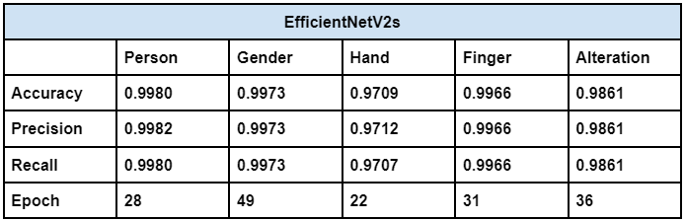
Results and Discussion
Comprehensive Fingerprint Recognition Utilizing One Shot Learning With Siamese Network
EfficientNetV2s
Department of Computer Science & Engineering, Brac University

Slide 16
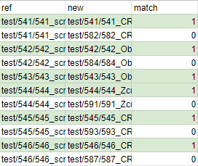
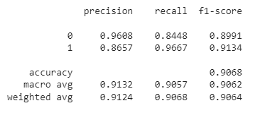
Results and Discussion
One Shot Learning Result Analysis with Customized Dataset
Comprehensive Fingerprint Recognition Utilizing One Shot Learning With Siamese Network
Here 0 represents match image and 1 represents different image

Slide 17
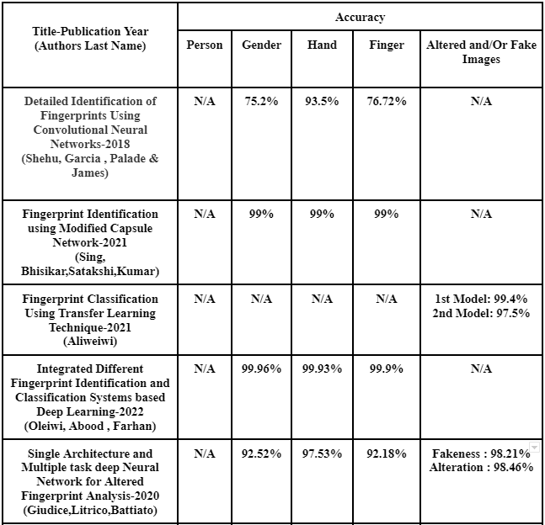
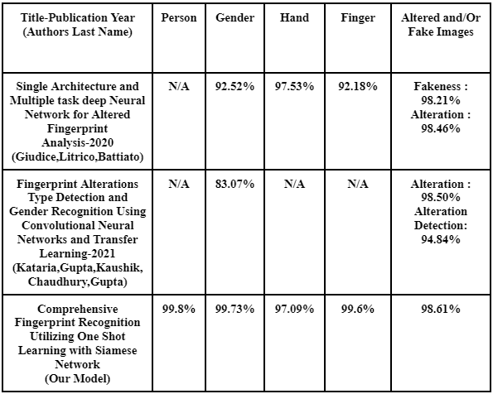
Comparison Of Works Done On SOCOFing Dataset
Comprehensive Fingerprint Recognition Utilizing One Shot Learning With Siamese Network

Slide 18
Conclusion & Future Directions
Comprehensive Fingerprint Recognition Utilizing One Shot Learning With Siamese Network
To conclude, Implementing One Shot Learning with Siamese network allowed us to:
Recognize person identity with only one reference image of a simple person
Reducing Cost and complexity of large data requirements
Substituting classification problem through retraining with difference evaluation problem of siamese network
Can identify unknown class without having to retrain the system.
Implementing EfficientNetV2s for classification allowed us to:
Identify a Person’s ID, Gender , Hand , Finger and alteration of fingerprint with very high accuracy
Each class acquired over 97% accuracy
Department of Computer Science & Engineering, Brac University

Slide 19
Conclusion & Future Directions
Comprehensive Fingerprint Recognition Utilizing One Shot Learning With Siamese Network
Future Directives of our works includes :
Using similar technologies in other compatible biometric applications.
Want to work with breathing identification using one shot learning
Classify breathing pattern if it is a healthy breathing or not
Department of Computer Science & Engineering, Brac University

Slide 20
References
Comprehensive Fingerprint Recognition Utilizing One Shot Learning With Siamese Network
Adam, E. E. B. (2021). Evaluation of fingerprint liveness detection by machine learning approach-a systematic view. Journal of ISMAC, 3(01), 16-30.
Aloweiwi, A. H. (2021). Fingerprint Classification Using Transfer Learning Technique.
Chicco, D. (2021). Siamese neural networks: An overview. Artificial Neural Networks, 73-94.
Giudice, O., Litrico, M., & Battiato, S. (2020, October). Single architecture and multiple task deep neural network for altered fingerprint analysis. In 2020 IEEE International Conference on Image Processing (ICIP) (pp. 813-817). IEEE.
Kadam, S., & Vaidya, V. (2020). Review and analysis of zero, one and few shot learning approaches. In International Conference on Intelligent Systems Design and Applications (pp. 100-112). Springer, Cham.
Kataria, G., Gupta, A., Kaushik, V. S., Chaudhary, G., & Gupta, V. (2021). Fingerprint Alterations Type Detection and Gender Recognition Using Convolutional Neural Networks and Transfer Learning. In Computational Intelligence for Information Retrieval (pp. 237-255). CRC Press.
Nguyen, H. T., & Nguyen, L. T. (2019). Fingerprints classification through image analysis and machine learning method. Algorithms, 12(11), 241.
Oleiwi, B. K., Abood, L. H., & Farhan, A. K. (2022, March). Integrated different fingerprint identification and classification systems based deep learning. In 2022 International Conference on Computer Science and Software Engineering (CSASE) (pp. 188-193). IEEE.
Shehu, Y. I., Ruiz-Garcia, A., Palade, V., & James, A. (2018, December). Detailed identification of fingerprints using convolutional neural networks. In 2018 17th IEEE International Conference on Machine Learning and Applications (ICMLA) (pp. 1161-1165). IEEE.
Shehu, Y. I., Ruiz-Garcia, A., Palade, V., & James, A. (2018). Sokoto coventry fingerprint dataset. arXiv preprint arXiv:1807.10609.
Singh, T., Bhisikar, S., & Kumar, M. (2021, July). Fingerprint Identification using Modified Capsule Network. In 2021 12th International Conference on Computing Communication and Networking Technologies (ICCCNT) (pp. 1-6). IEEE.
Department of Computer Science & Engineering, Brac University

Slide 21
Thank You.
Questions or Suggestions?
Comprehensive Fingerprint Recognition Utilizing One Shot Learning With Siamese Network
Department of Computer Science & Engineering, Brac University

